Slide 1

Made by Amir-Georges Haya

Slide 2
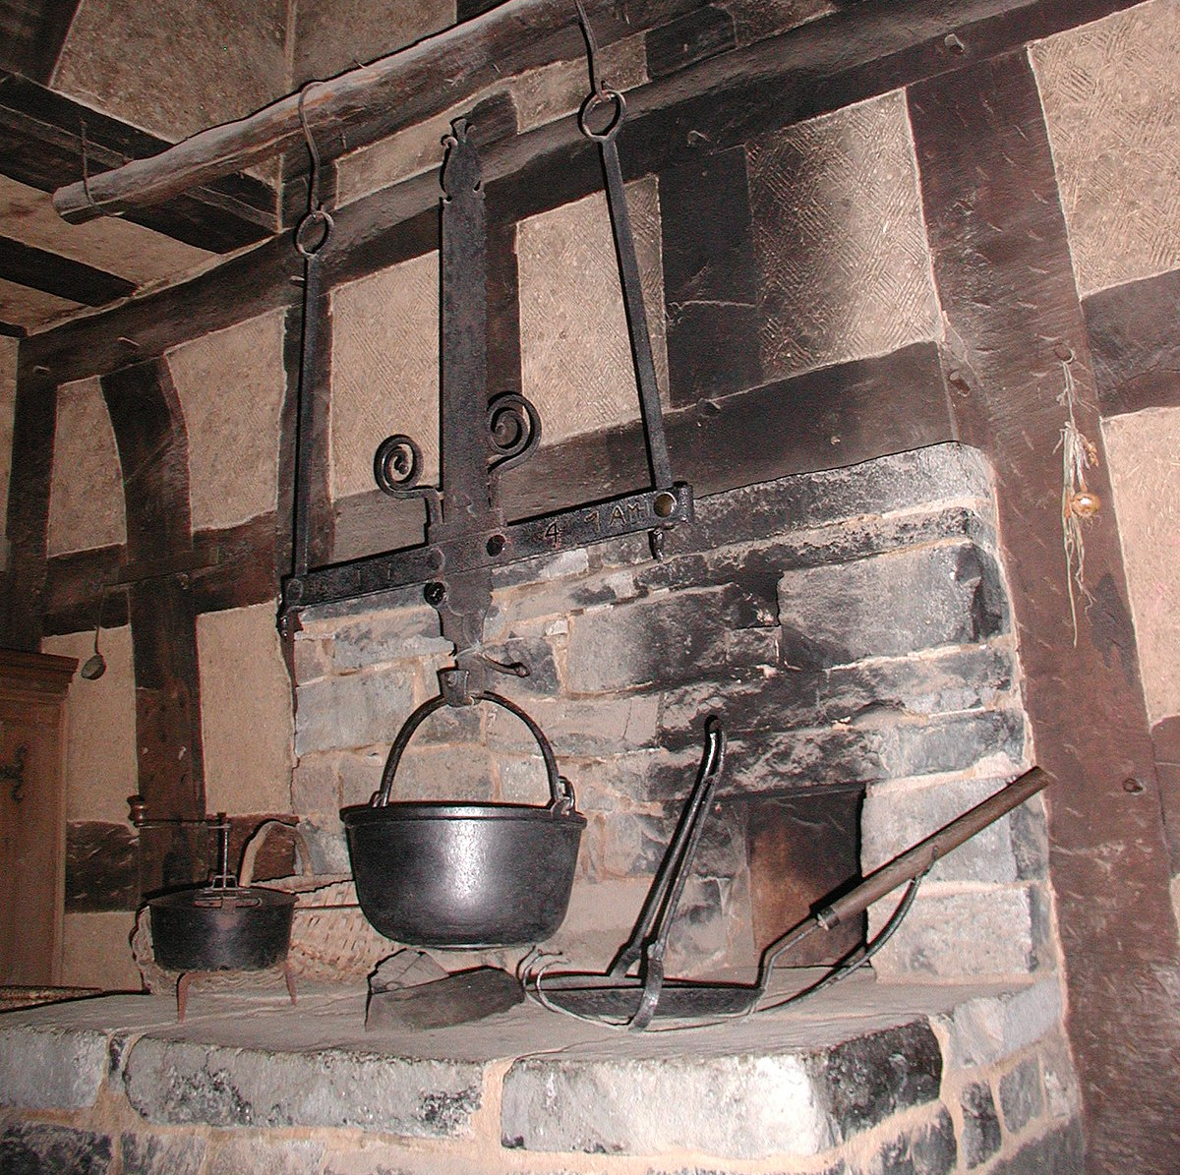
Heaven Hearth: the inspiration
Heaven: Religious cosmological (making sense of the world through religion) where deities, angels, etc live.
Hearth: The place in a home where fire is kept for heating.
Why the name:
Hearth: A fireplace is usually used in literature to describe a warm place (a place that feel comforting).
Heaven: used in literature when something achieves something even higher than content or happiness.
Notes:
https://upload.wikimedia.org/wikipedia/commons/thumb/9/96/RFK-005-Feuerstelle-im-17-Jh.JPG/1200px-RFK-005-Feuerstelle-im-17-Jh.JPG

Slide 3
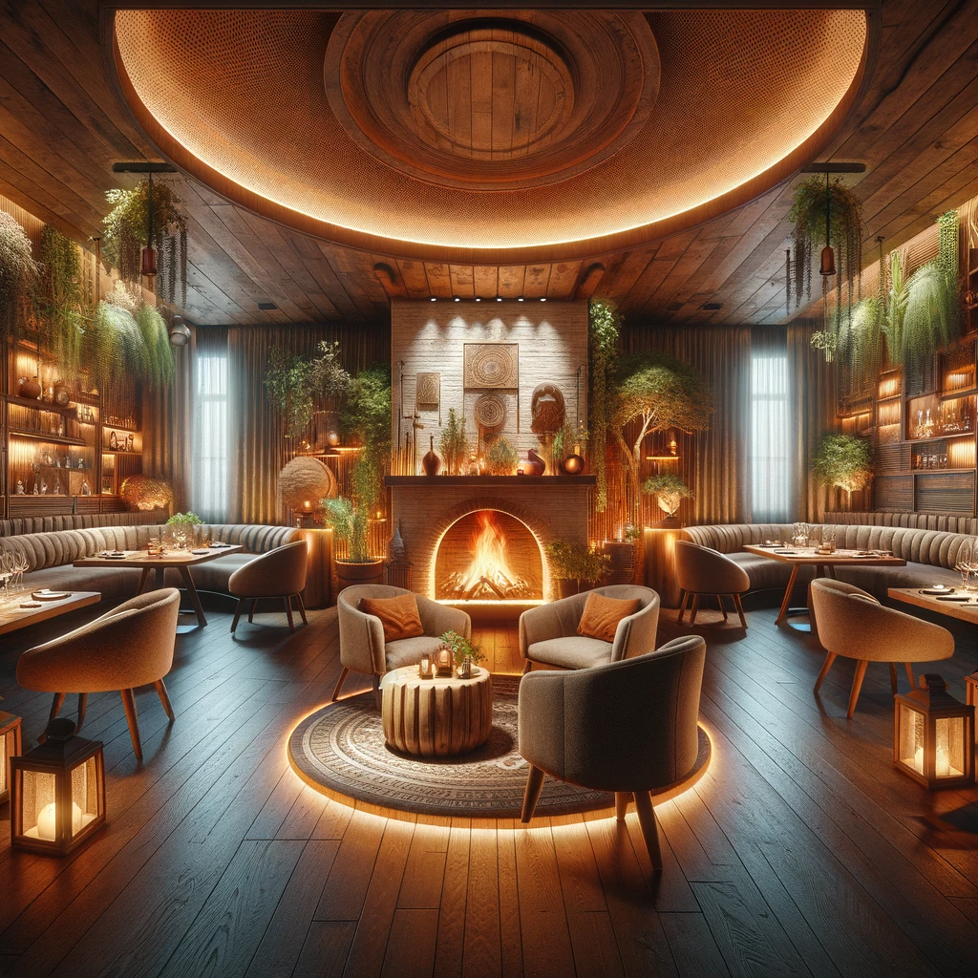
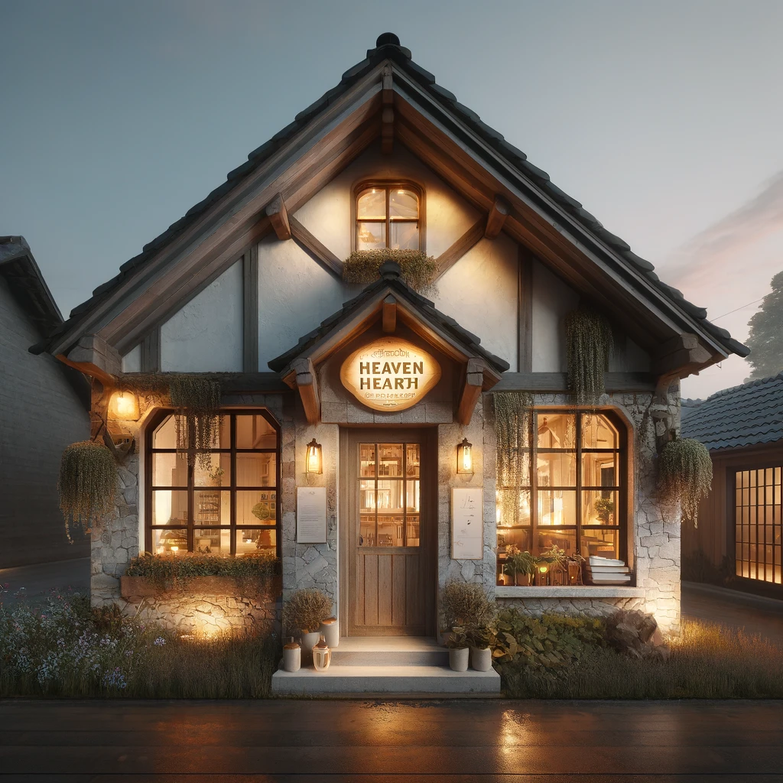
About Heaven Hearth
Heaven Hearth is a cozy restaurant that provides good entertainment and food. Whether you are going to get your fill or just want a cozy atmosphere, Heaven Hearth is the place for you! Our restaurant thrives on quality food but also quality environment by giving the consumer the best of the best afternoon and late night entertainment thanks to our incredible animatronics created and in collaboration with agreeing companies.

Slide 4
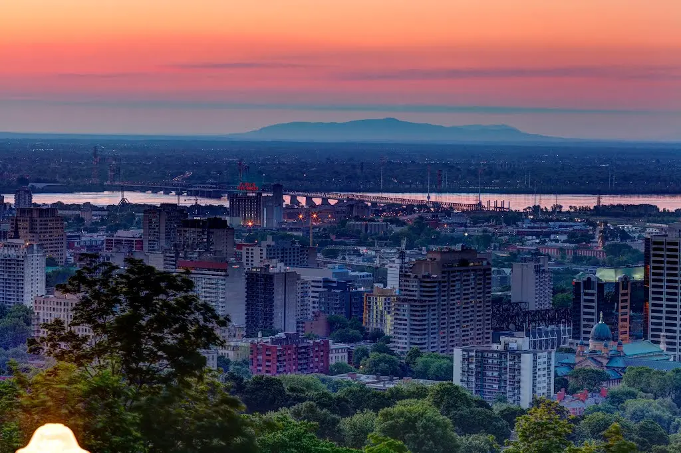
Scheduling
Days | Time
Monday | Closed
Tuesday | 8AM – 5PM
Wednesday | 8AM – 5PM
Thursday | 8AM – 10PM
Friday | 8AM – 12PM
Saturday | 8AM – 12PM
Sunday | 8AM – 12PM

Slide 5
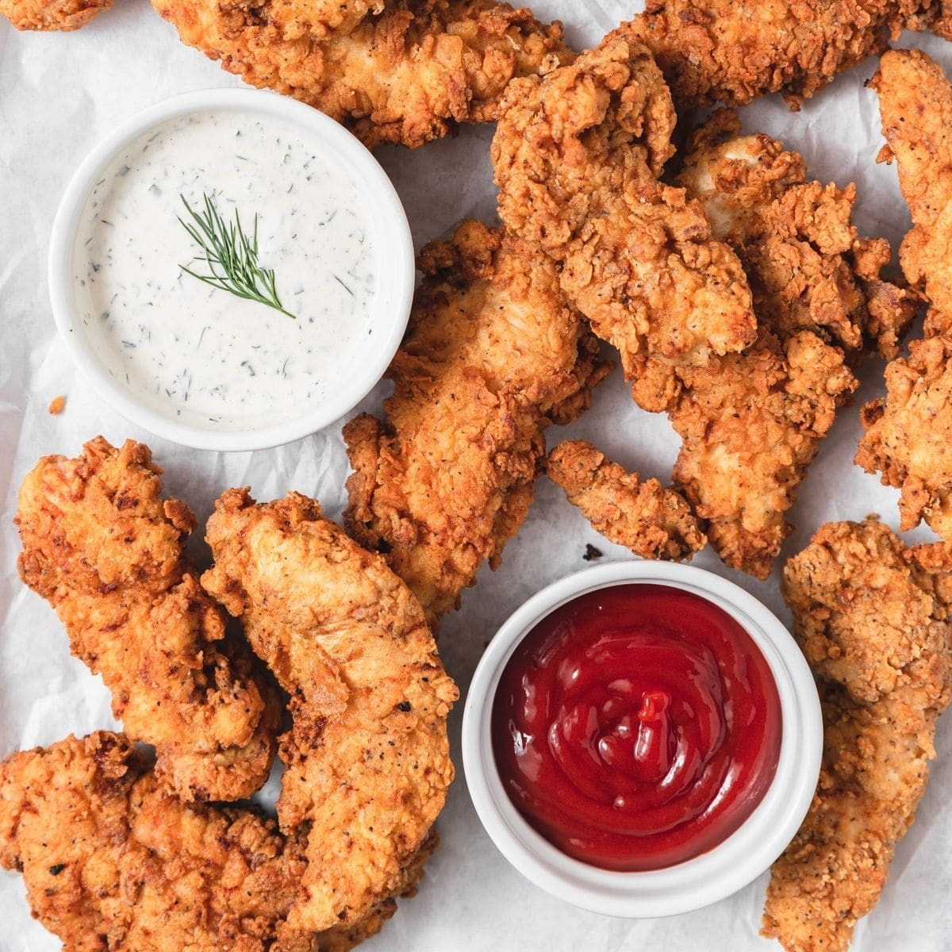
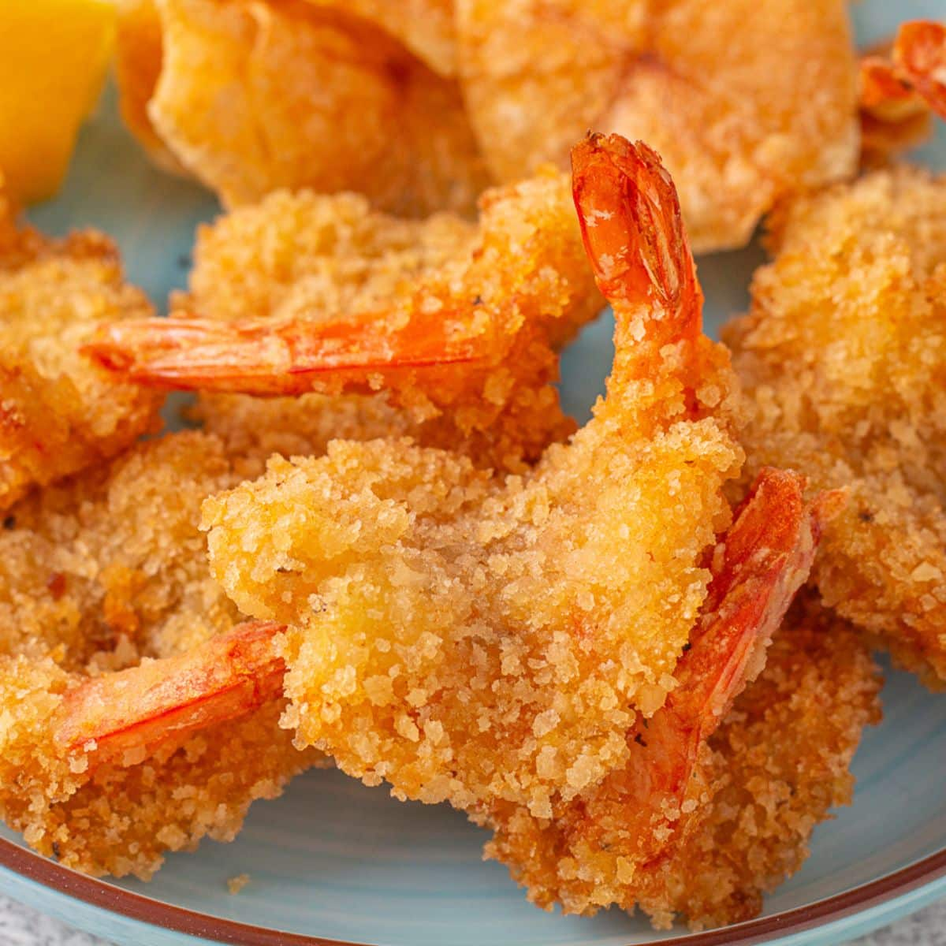
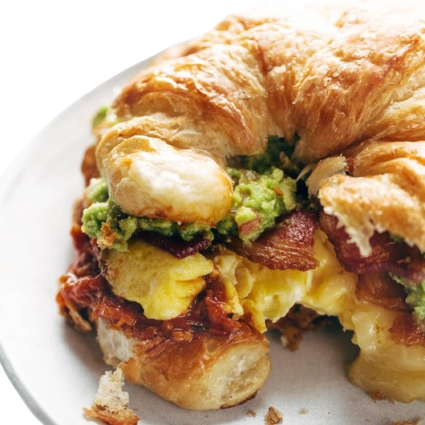
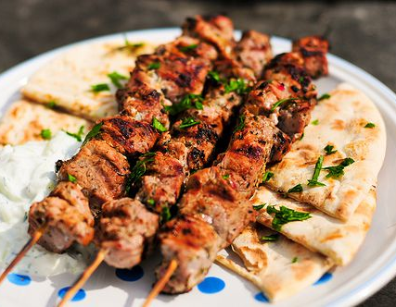
Menu
Separated in 7 groups:
Specials
Breakfast
Dinner
Supper
Kids Menu
Drinks
Desserts

Slide 6
Reservations
Number People | Prices
1-2 | 15$
3-5 | 20$
6-10 | 45$
11+ | 65$
Types of Seats | Prices
1-2 | No fee
3-5 | 15$
6-10 | 45$
11+ | 65$

Slide 7



Entertainers: Creators of atmosphere
Purpose: To bring atmosphere to the restaurant!
Entertainers: Animatronic-based (similar to a robot)
Name: Jigglypuff, Freddy Fazbear, Kass all bring something different to the atmosphere

Slide 8

Contact information: Help the user contact you!
Email: HeavenHearth@gmail.com
Phone Number: 438-501-0341
Find us at: 150 Saint-Catherine St W, Montreal, Quebec, H2X 3Y2
Instagram: @HeavenHearth

Slide 9
Implementations
Responsive layout using flex display
All websites uses CSS and HTML
Usage of Local storage using JSON
Receipt file using JavaScript
Receipt display using JavaScript

Slide 10

Website design

Slide 11
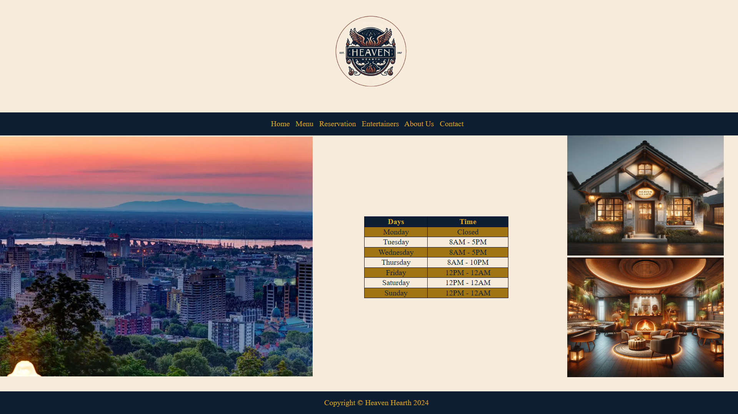
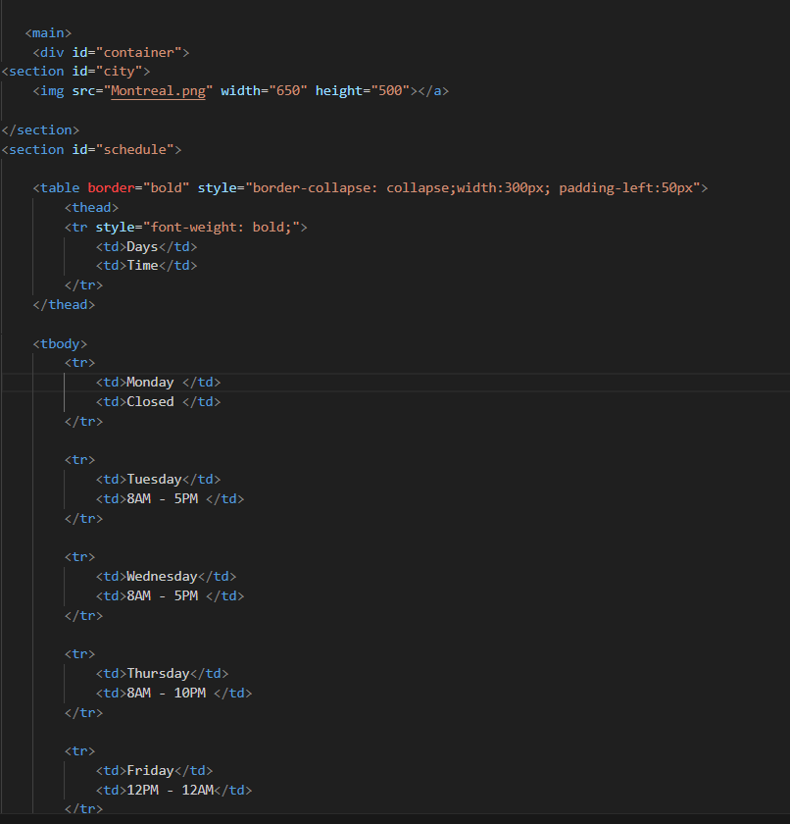
Homepage

Slide 12
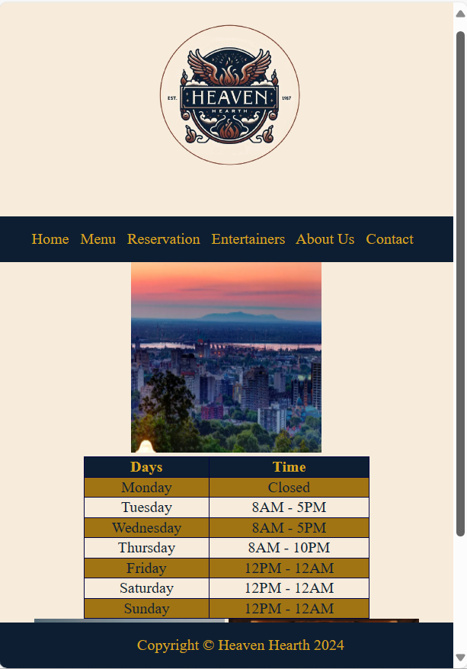
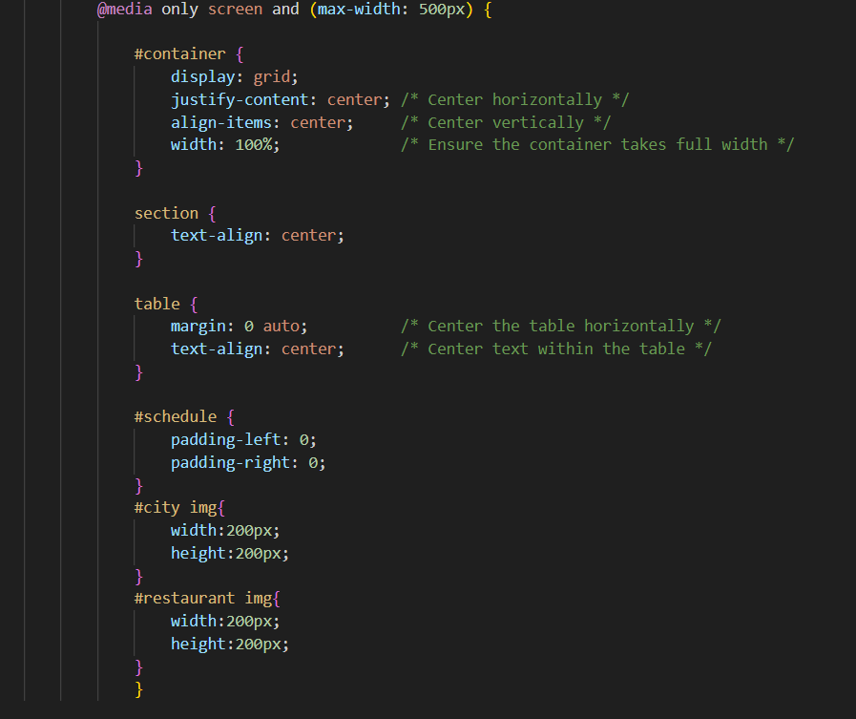
Homepage for smaller screens
Images scaled down for better view

Slide 13
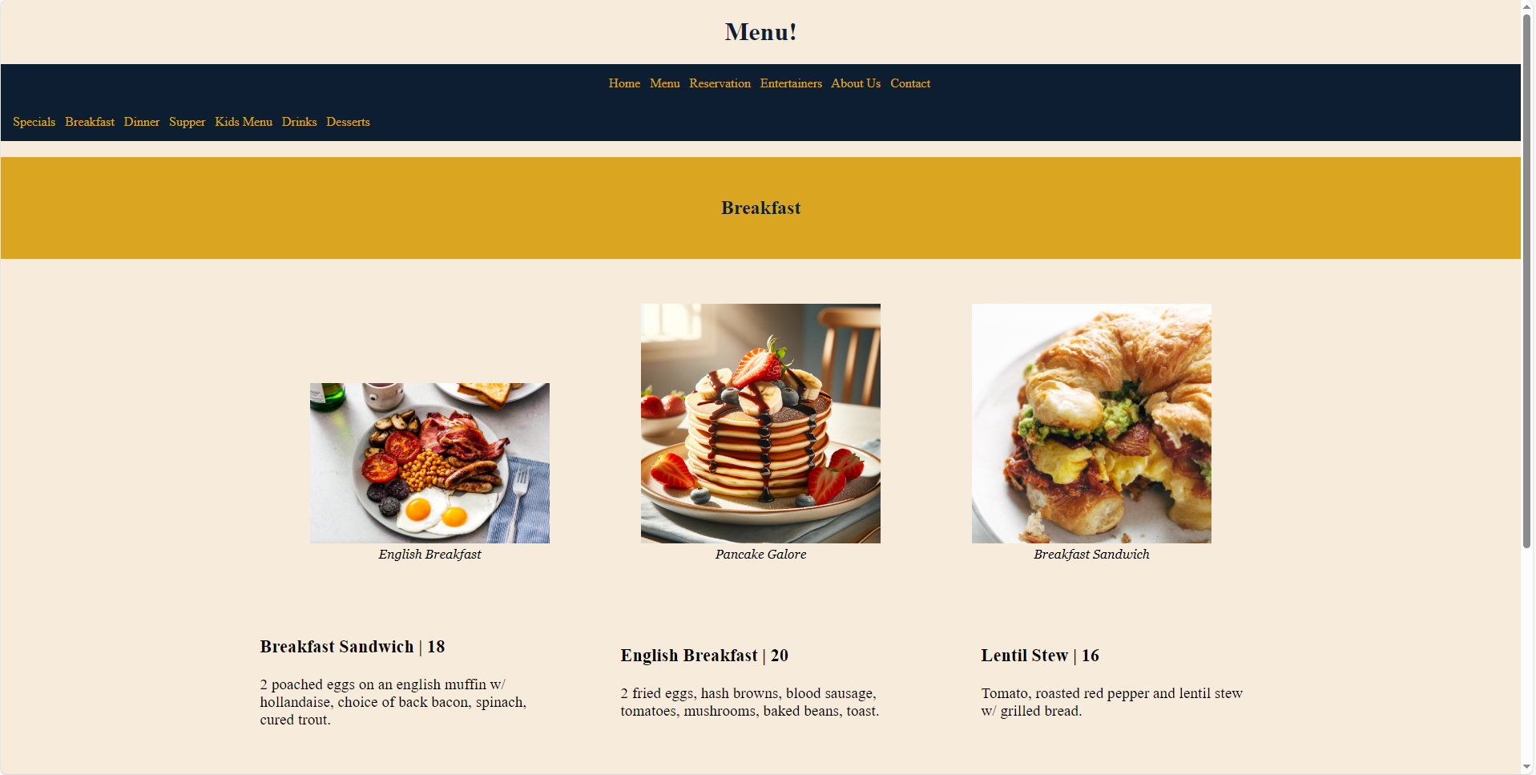
Menu

Slide 14
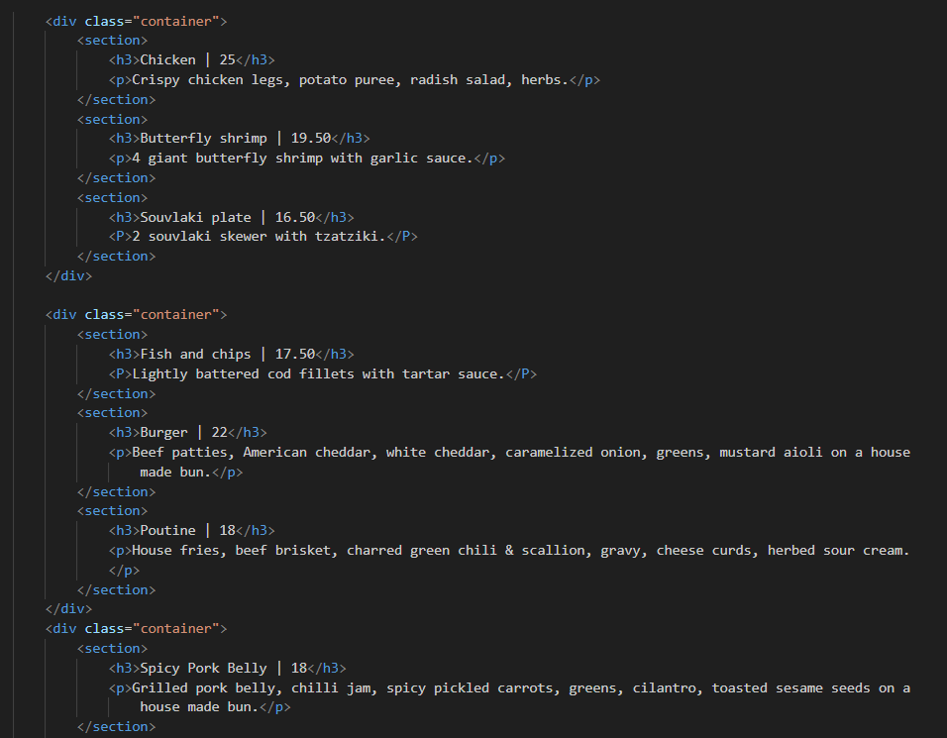
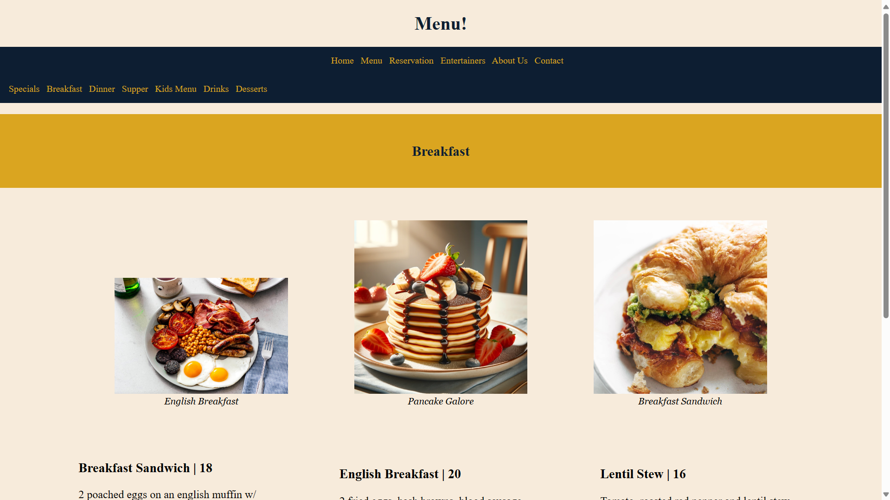
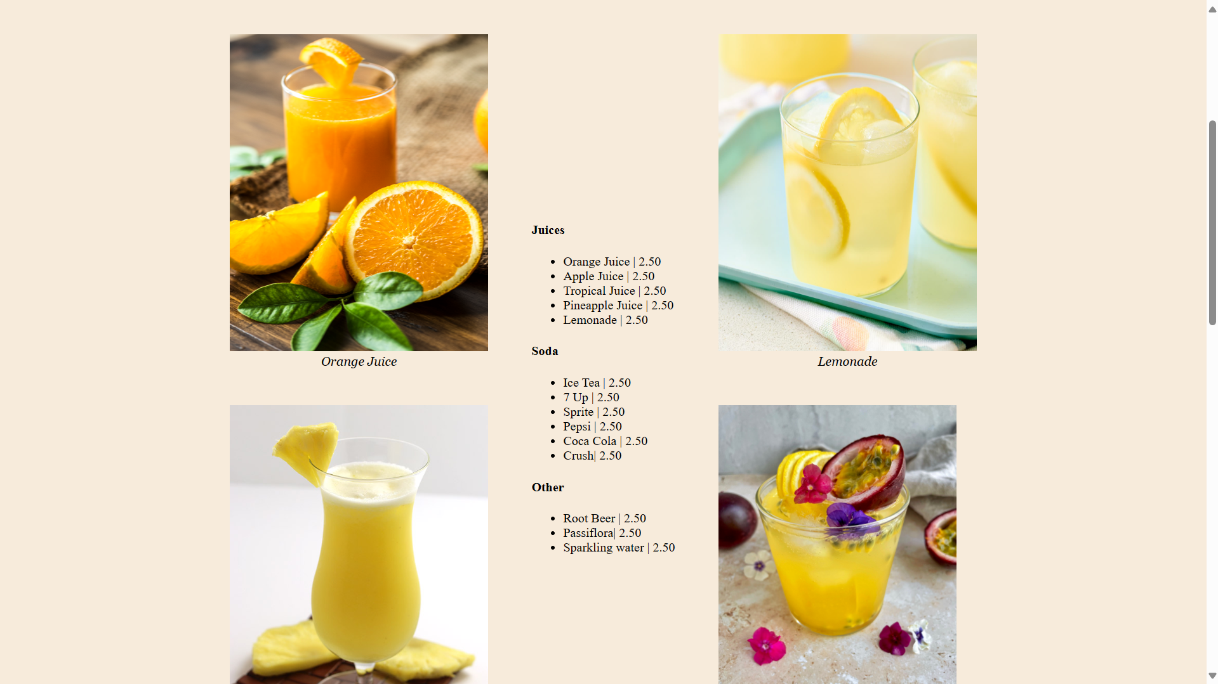
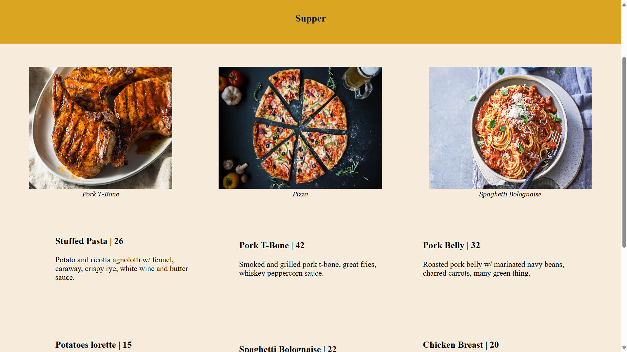
Menu (2)

Slide 15
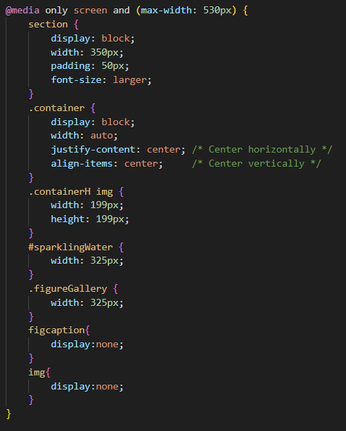
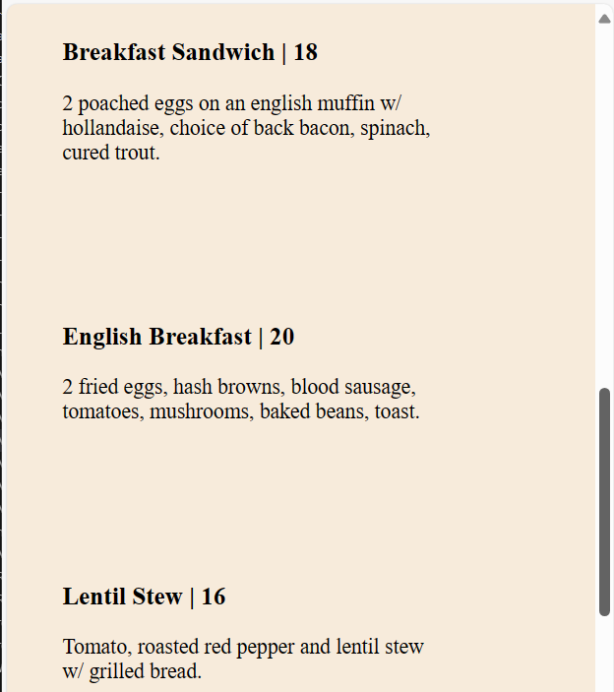
Menu for smaller screens

Slide 16
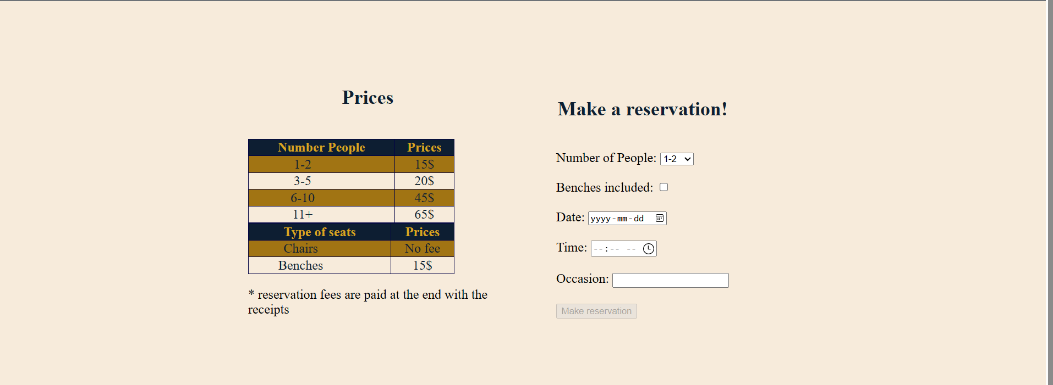
Reservation
Reservations are based on two factors:
Number of people
Seat types

Slide 17
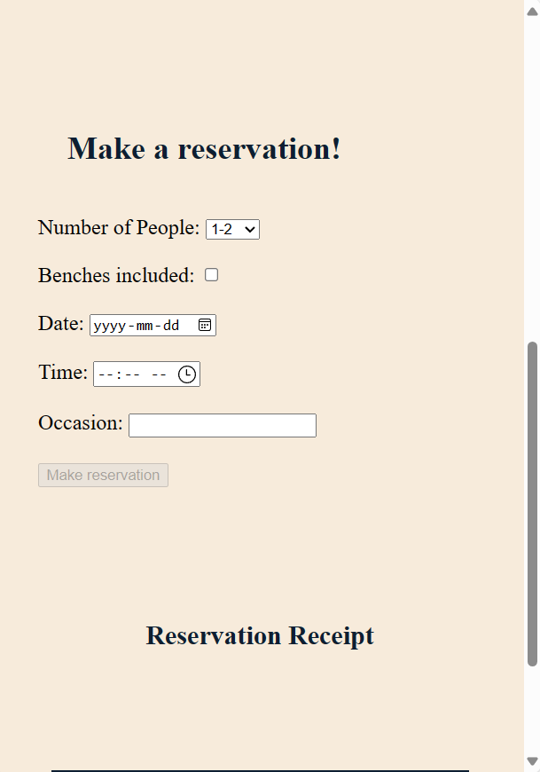
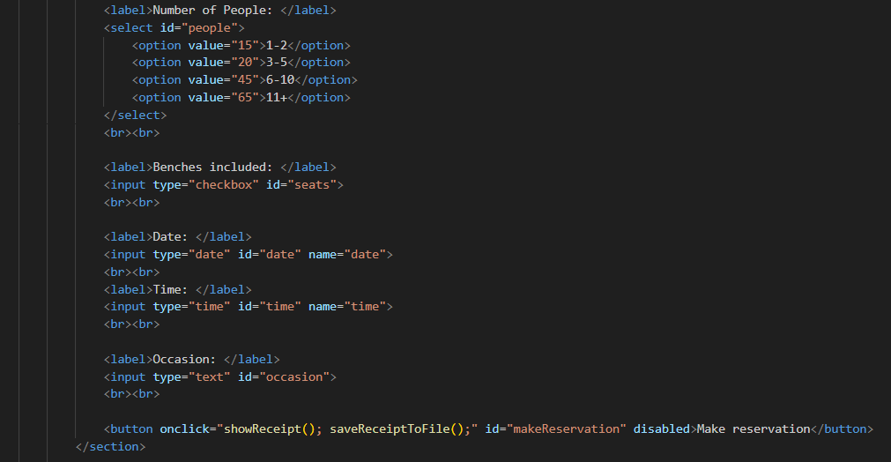
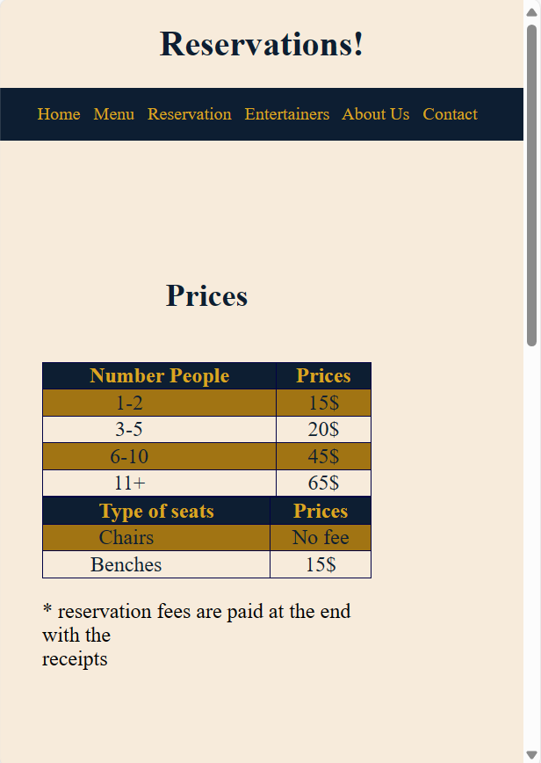
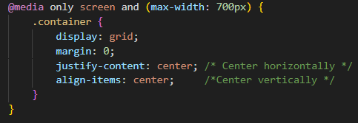
Reservations for smaller screen

Slide 18
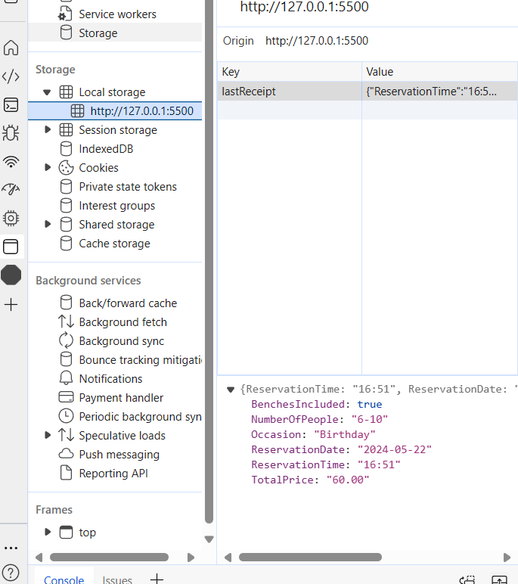
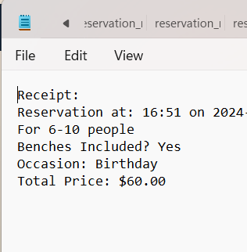

Reservation

Slide 19
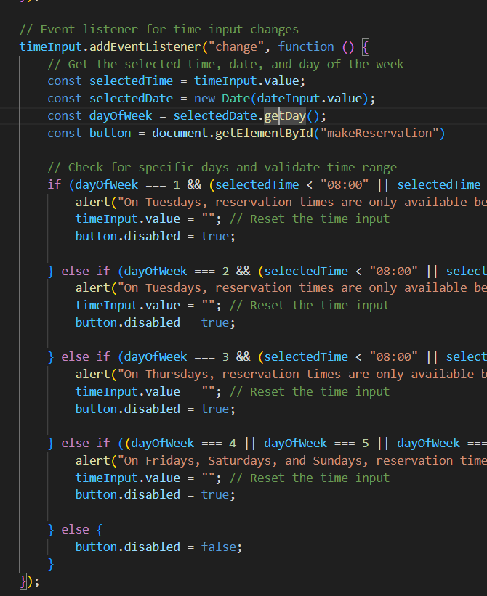
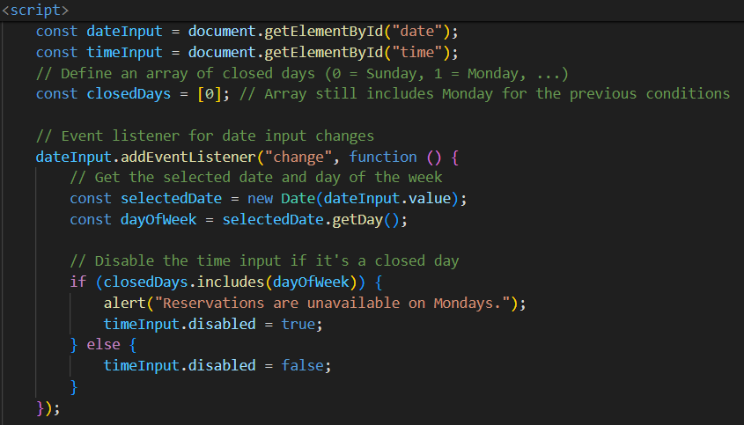
Code Usage for Scheduling
Makes sure that the user can’t reserve when the restaurant is closed.
dayOfWeek represents a value of a day (0-6). 0 is Monday while 6 is Saturday.
closedDays represents an array of days that are closed, in this situation, it’s only Monday

Slide 20
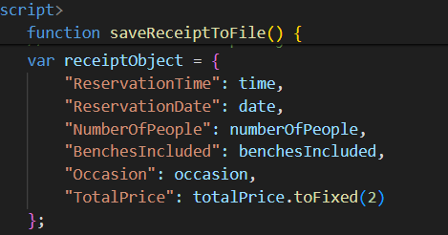
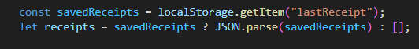
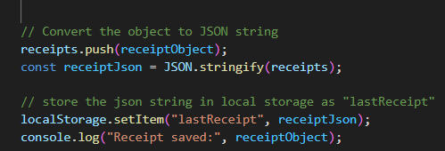
Reservation: Schedule creator
Variables are taken by the form submission if it is valid.
Two variables are created: receiptContent which will be converted to a textfile as receipt for the user. receiptIbject will be used to store in the local storage.

Slide 21
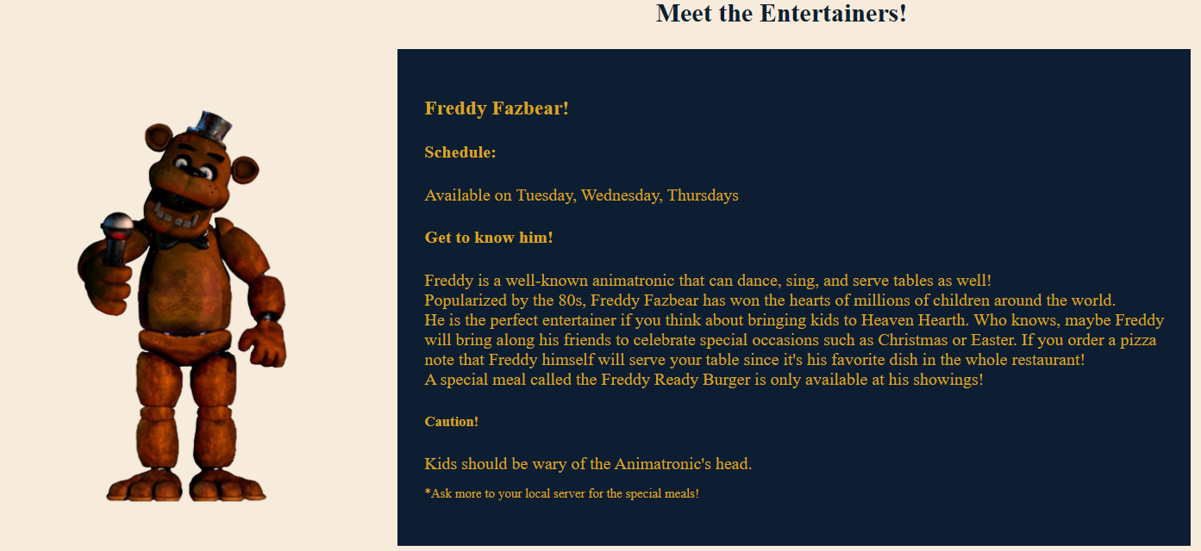
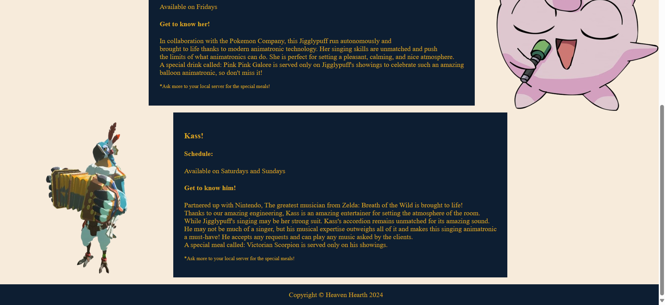
Entertainers
Each entertainer has its special meal attributed to them.
All legally created with no copyrighted problem whatsoever!

Slide 22
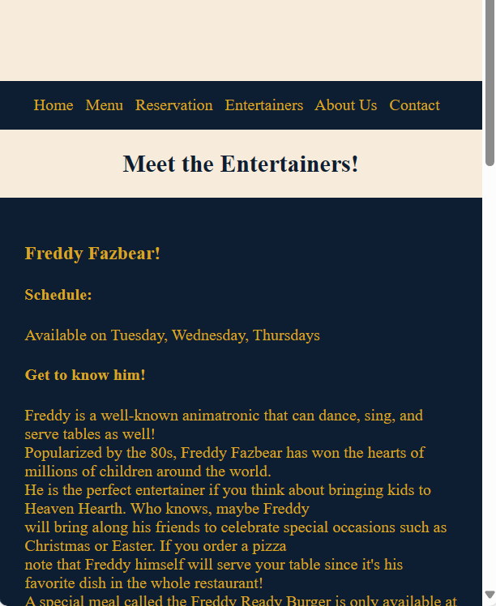
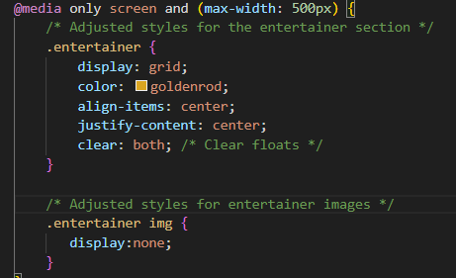
Entertainers (smaller screen)
Photos are not available for better clarity and feel.

Slide 23
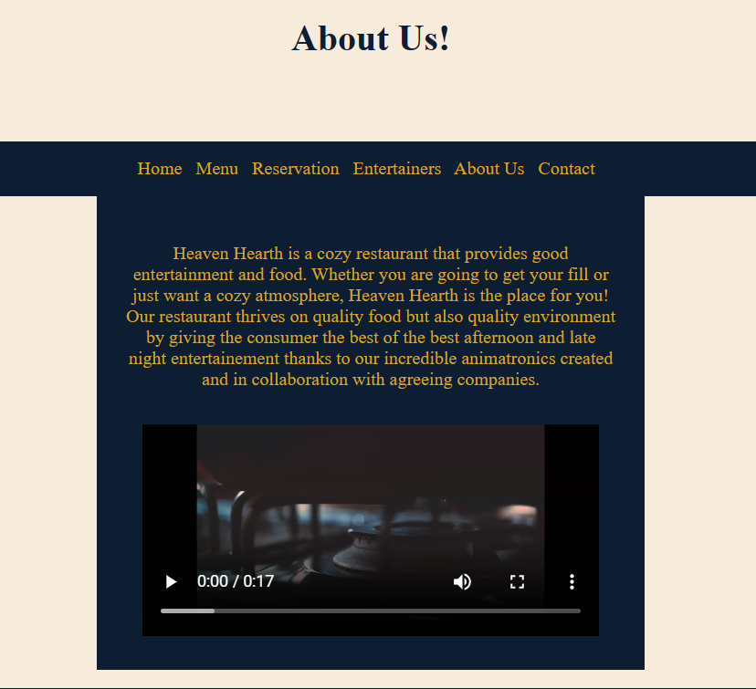
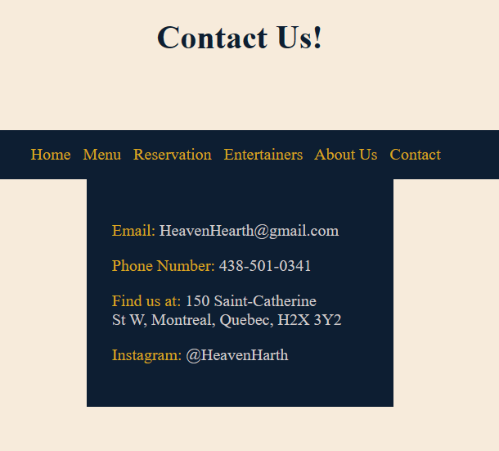
About Us and Contact

Slide 24

THANKS FOR LISTENING

